Slide 1
German Text Archive / DWDS & Case Studies

Slide 2
Plan for today
Examples for corpus-based research on the history of (more recent stages of) German
DWDS and the German Text Archive
Hands-on examples

Slide 3
Some example studies

Slide 4
Example studies
Graphemics: Functional expansion of the apostrophe <'>
Morphology: Word formation change
Morphosyntax: the x-er the y-er

Slide 5
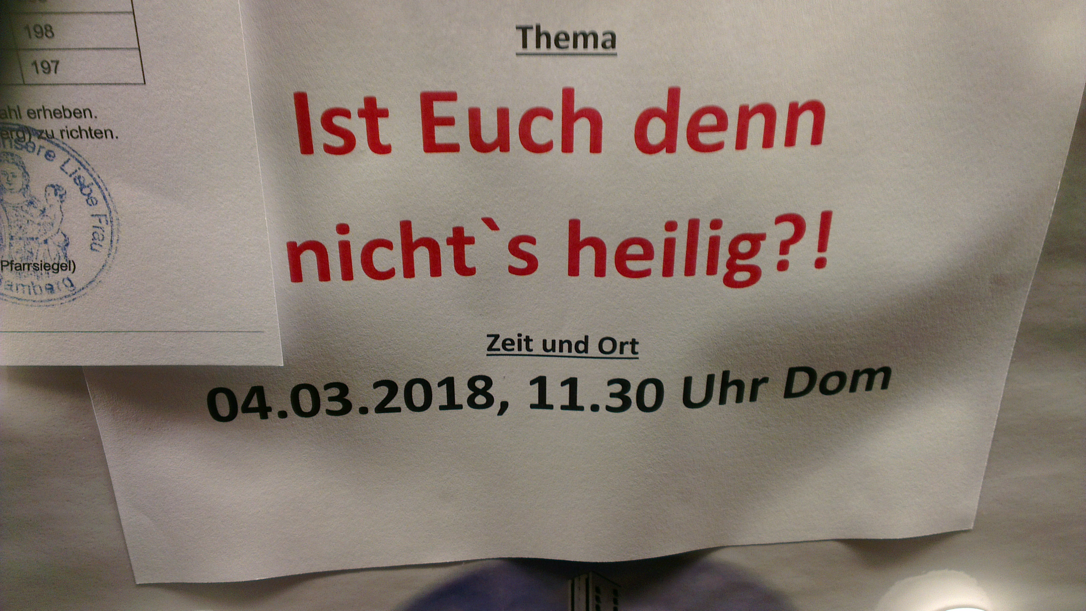
(Vortragsankündigung im Bamberger Dom)

Slide 6
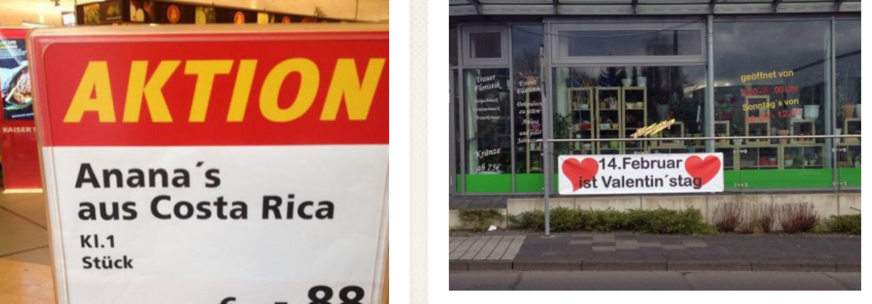
Apostrophe (Scherer 2013)
phonographic apostrophe: habe es > hab's, gibt es > gibt's
morphographic apostrophie: Moni's Friseursalon, Dienstag's Schnitzeltag

Slide 7
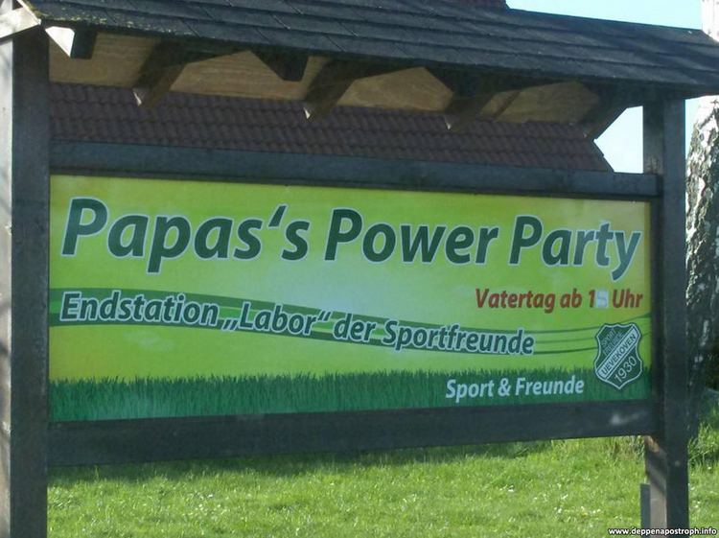
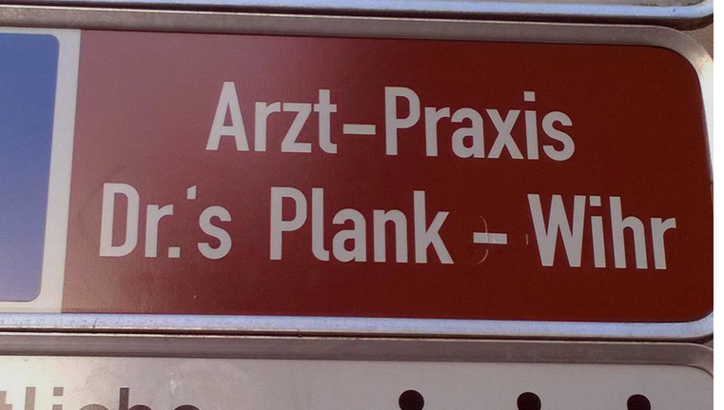
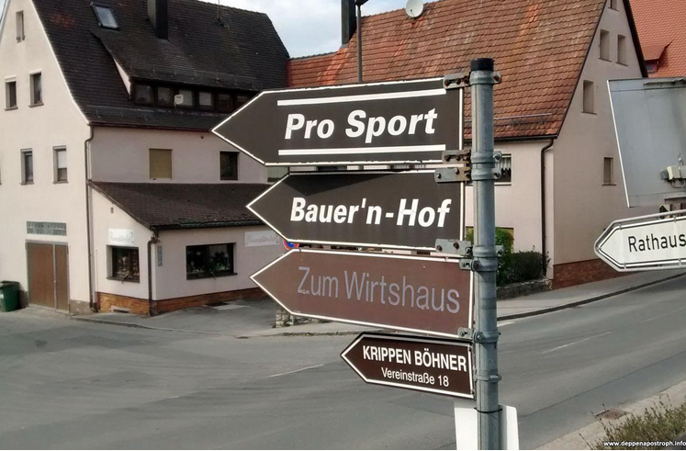

Slide 8
Elision apostrophe
The elision apostrophe is a so-called syngrapheme → marks omission of elements in a word
Usually vowels are subject to elision
consonants are omitted rarely – if so, usually in combination with vowels: für den > für'n
Elisions can be word-initial, word-medial, or word-final
(aus Klein 2006)
Notes:
Syngraphem: Ein Graphem, das zusammen mit anderen Graphemen auftritt. Alle Interpunktionszeichen sind Syngrapheme.

Slide 9
Elision apostrophe
Elision is, first and foremost, a phonological phenomenon
Elision apostrophes stand for omitted sounds → phonographic representation
(vgl. Klein 2006)

Slide 10
From phonographic to morphographic apostrophe
Especially in non-standard writing, the apostrophe can also signal morpheme boundaries
Scherer (2013): Howe frequent is the morphographic apostrophe in written German, and which factors determine its use?

Slide 11
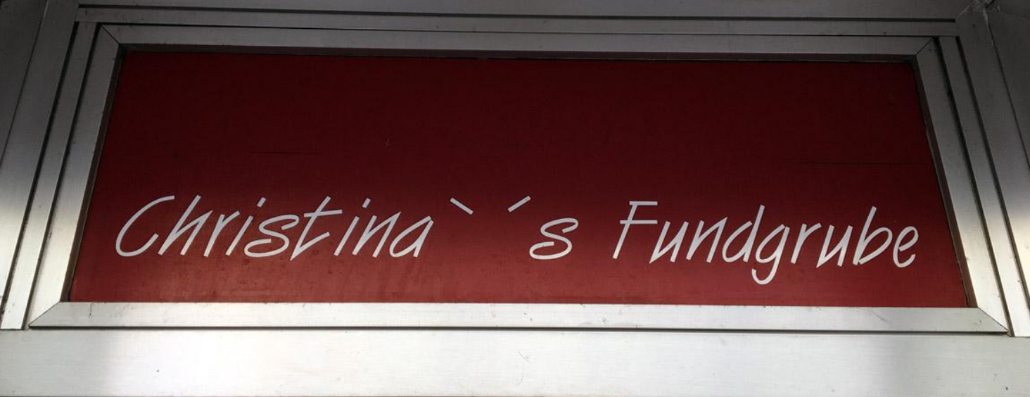
Results
10-20 % of apostrophes in her corpus are morphographic
morphographic apostrophe especially for marking genitives with person names → prototypical context

Slide 12
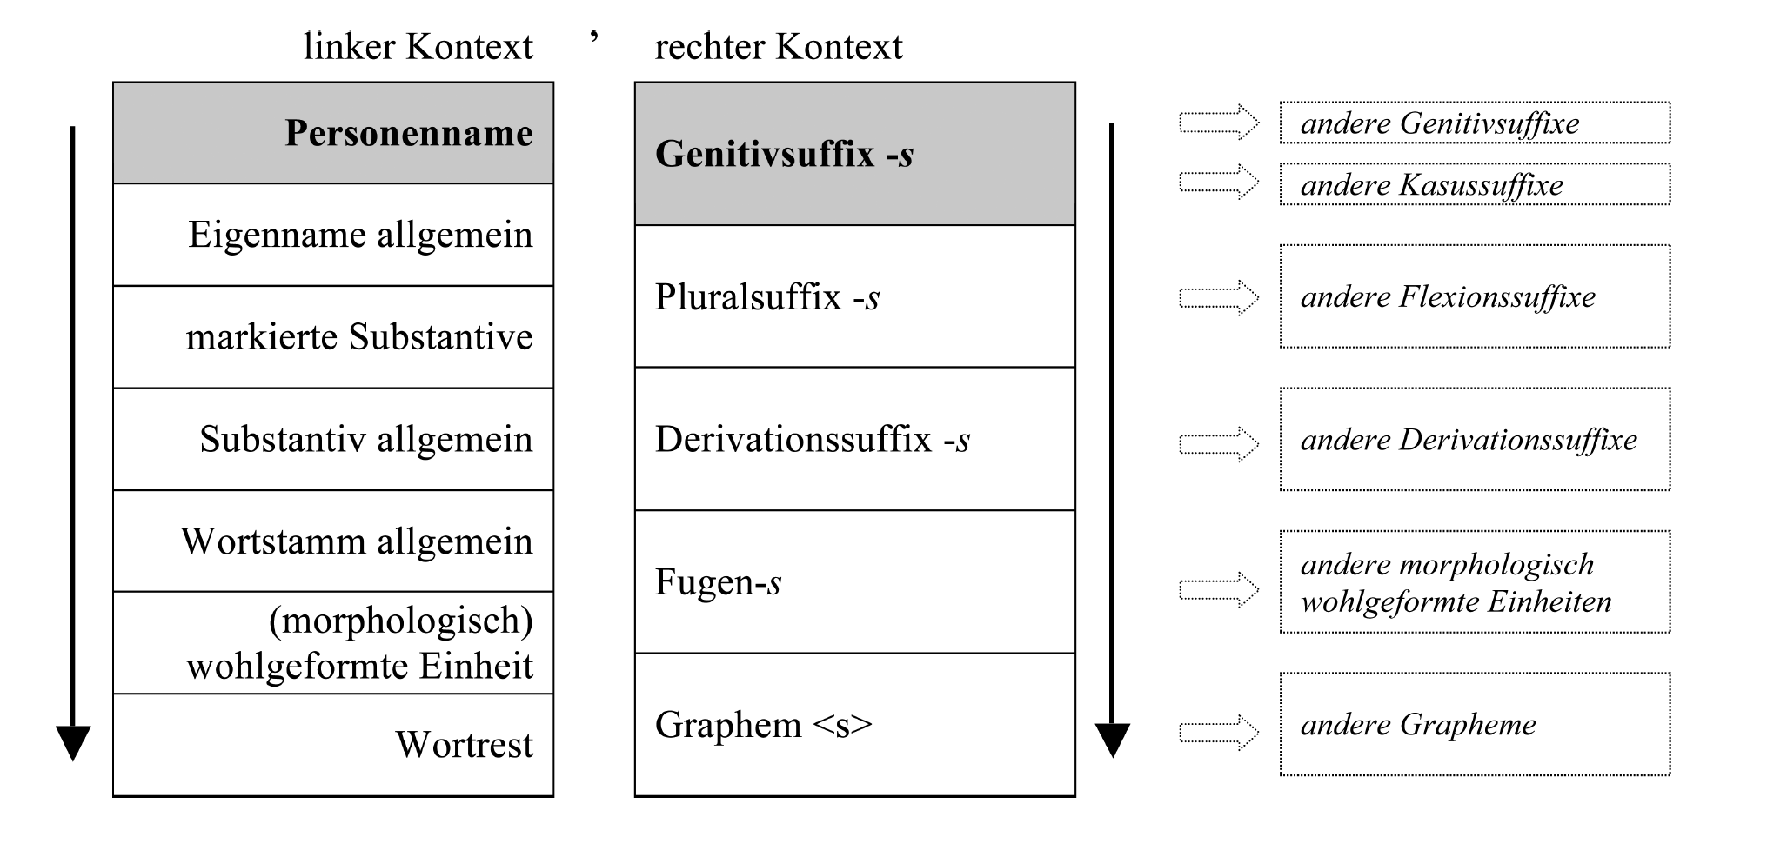
Results
functional expansion of apostrophe

Slide 13
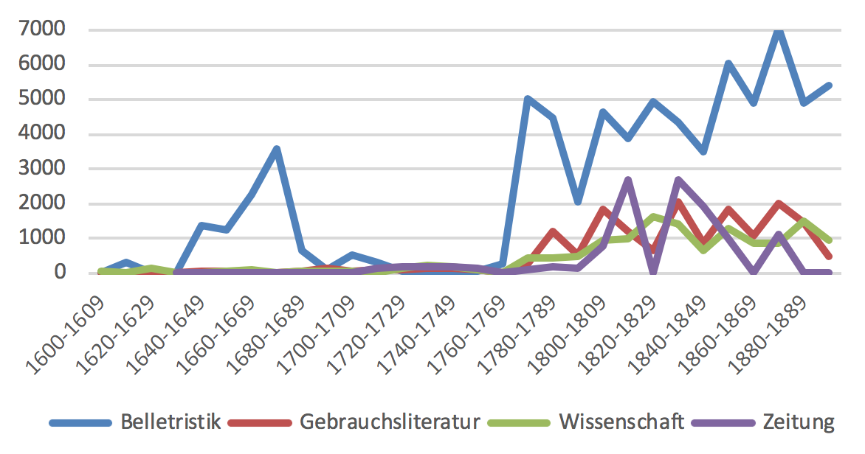
Apostrophe in the DTA
(Frequency per million words, Kempf 2019)

Slide 14
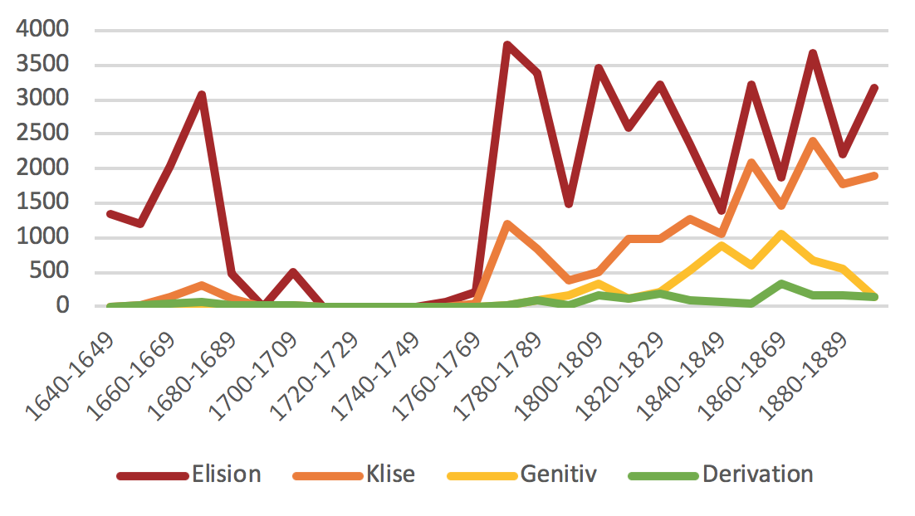
Apostrophe in the DTA
schöneren > schön'ren
es ist > 's ist
in das > ins
gibt es > gibt's
Stefan's
Luise's
Angesicht's
Wolff'sche
(only fiction texts, from Kempf 2019)

Slide 15
Morphographic apostrophe in the DTA
apparently reanalysis: phonographic elision marker > morphographic boundary marker
Gott's Wahrheit 'God's truth' (< Gottes)
>
Bonaparte's Benehmen 'Bonaparte's behavior'

Slide 16
Development of genitive apostrophe
Kempf (2019): zwei "haydays" of genitive apostrophe, first in the 17th century, then in 18th/19th century
probably no continuity between these high-frequency phases:
In the first phase, the genitive apostrophe predominantly combines with native appellatives, in the second one with proper names (in the beginning, mostly non-native ones)
Declins in morphographic apostrophe types towards the end of the 19th century

Slide 17
Wrap-up on genitives
Apostrophe can contribute to making morphology "visible"
in present-day German standard orthography, it can only function as an elision marker
in non-standard writing its morphographic function is retained (or is coming back)
... even in cases where the apparent morphological structure is the result of reanalysis!

Slide 19
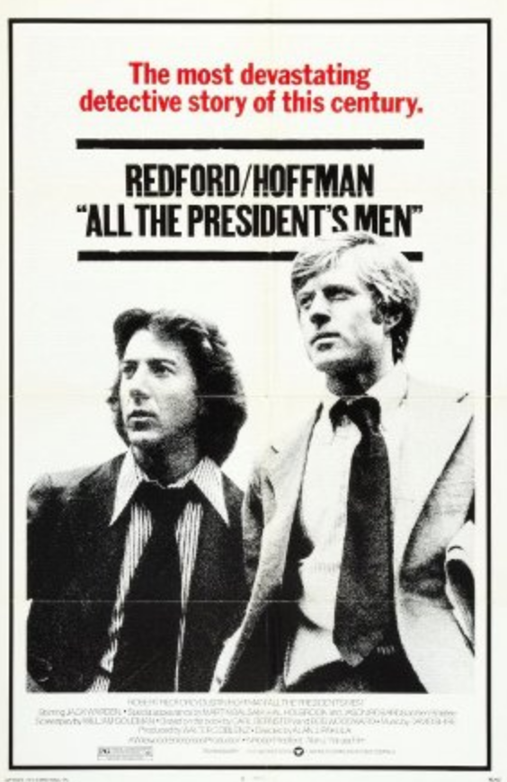
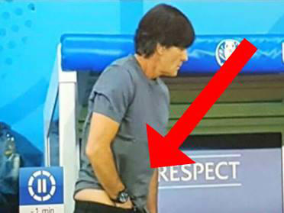
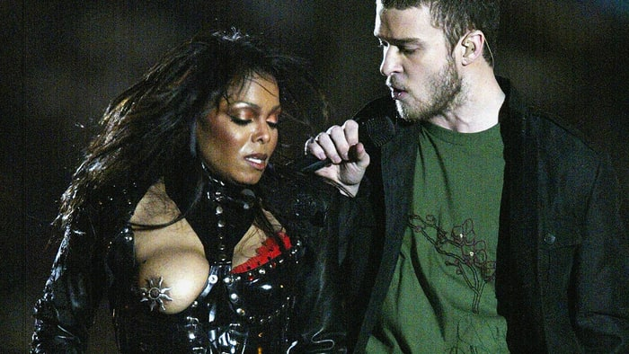
Word-formation change: -gate
Nipplegate
Hosen-Gate
Watergate

Slide 20
-gate as an onymic confix
-gate as an onymic confix: it is used to derive proper names
unlike common nouns, proper names are characterized by
monoreference: referring to exactly one entity (e.g. Alexander Bergs)
direct reference: no "detour" via potential / prototypical meaning
Notes:
Direktreferenz: Beispielsweise kann das Wort "Hund" auf alle möglichen Hunde referieren, vom Chiwawa bis zum Pitbull. Nur im Kontext kann es sich ggf. auf genau einen bestimmten Hund beziehen.

Slide 21
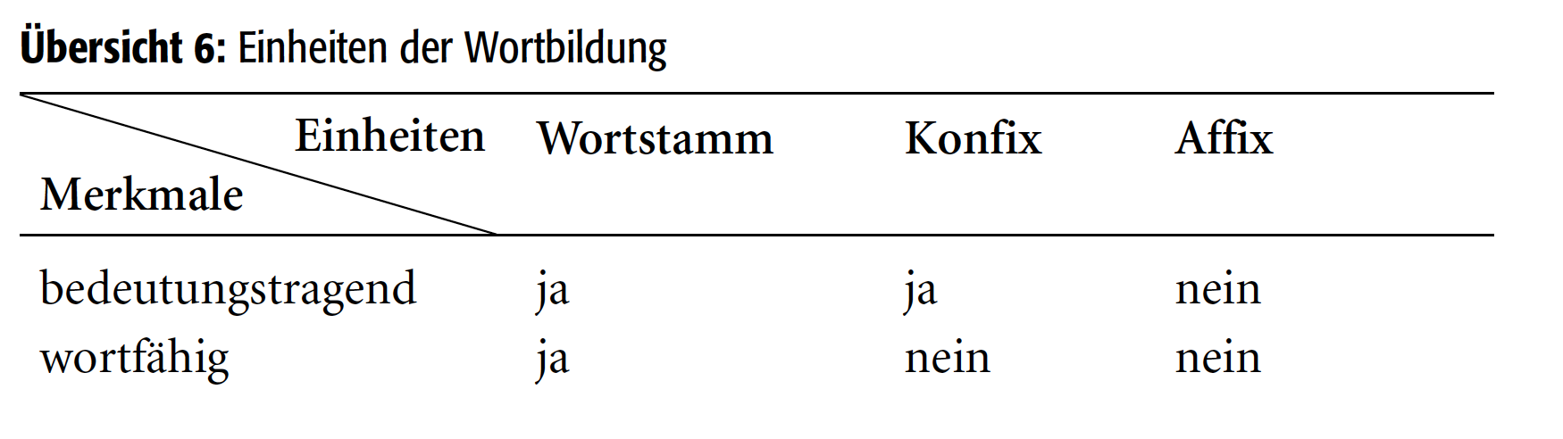
-gate as a confix
Confixes share properties with affixes and with free words:
like affixes, they are bound to a stem;
like free words, they carry lexical meaning.
(Fleischer & Barz 2012: 64)
Notes:
allerdings: umstrittene Kategorie und keine sehr einheitliche Klasse von Wortbildungseinheiten.
"Auch bestimmte indigene Wortsegmente kann man den Konfixen zuordnen, allerdings stellen sie eine Randerscheinung dar. Es handelt sich um wenige Einheiten, die in älteren Sprachstufen Lexeme waren, heute aber infolge ihrer Archaisierung nicht mehr wortfähig sind wie lotter-, schwieger-, stief-, winz-, -falt, in Lotterwirtschaft, Schwiegervater, Stiefsohn, Winzling, Einfalt (zur Abgrenzung von Konfix und unikalem Morphem ¢1.6.5). Sie sind weitgehend inaktiv, wenngleich gelegentlich Okkasionalismen wie Stiefhund, Schwiegermonster (Filmtitel), Winzort begegnen. Ein Grenzfall ist -wart: Als positionsfestes Zweitglied begegnet -wart in Geräte-, Haus-, Platz-, Tank-, Torwart, als Substantiv ist es veraltet (Wart ,Hüter, Aufseher‘)."

Slide 22
Confix vs. affixoid
Affixoid as a unit between word and affix
unlike confixes, affixoids are characterized by semantic bleaching
e.g.: Riesenkrach 'giant noise' (not *'nouse of a giant'), Laubwerk (not a 'work', but a collective noun for fallen leaves)
disputed concept (vgl. z.B. Schmidt 1987, Stevens 2005)

Slide 23
-gate as an onymic concept
reanalyzed from Watergate
first –gate formations in English as early as 1972/73 (time of Watergate affair)
became productive in German in the last few years as well, e.g. Hosen-Gate
(vgl. Flach, Kopf & Stefanowitsch im Ersch.)

Slide 24
Examples (from Wortwarte)
"Schnell war von " Guacamole-Gate " die Rede . Die Debatte nahm beinahe Loriot'sche Dimensionen an , frei nach dem Motto : Die Erbse bleibt draußen !"
Falls hier eine Trennwand geplant war, fehlt für ihre Installation der nötige Platz. Unter Mitarbeitern des russischen Außenministeriums kursiert noch eine zweite Erklärung, wie es zum "Toiletten-Gate" kommen konnte.

Slide 25
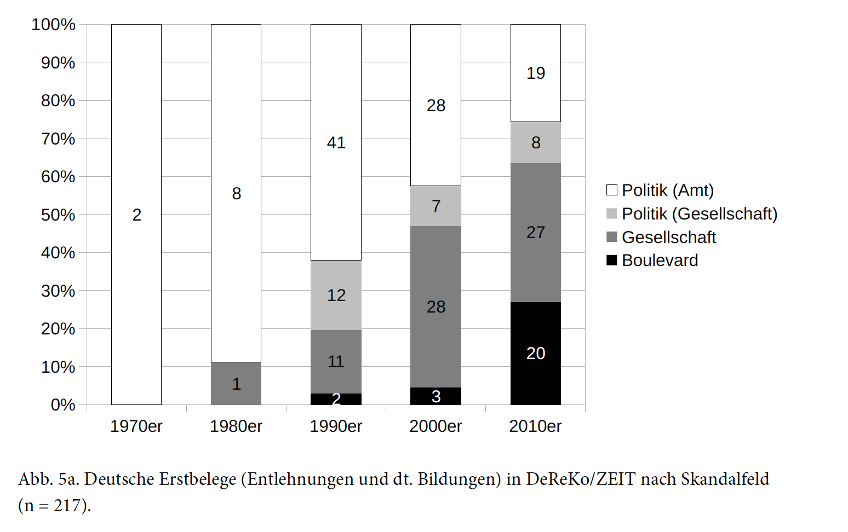
Development
aus Flach, Kopf & Stefanowitsch (im Ersch.)
Notes:
misconduct in office – societal scandals of politicians (e.g. extramarital affairs), societal scandals more generally, boulevard

Slide 26
Example
How can we search for -gate formations in a corpus of present-day German?
How can we make sure to exclude expectable false positives?

Slide 27
Meaning shift of -gate
Flach et al. (2018) show that -gate in German is subject to "trivialization": from big political scandals to smaller boulevard affairs
Are there similar developments in other domains?

Slide 28
"X-phemism mill"
Expressive meanings tend to show signs of attrition over time
e.g. scheiße 'shit, crap': de-tabooization over the course of the (late) 20th century
Allan & Burridge (2006): "X-phemism mill" –euphemysms and dysphemisms tend to loose their expressive meaning and become replaced by new ones
cf. e.g. MHG kranc 'weak' > NHG krank 'ill'
Notes:
ähnl. engl. bloody: bei der Uraufführung von Bernard Shaws Pygmalion noch skandalträchtig, heute fast schon euphemistisch

Slide 29
Expressivity
concept often used quite vaguely
Traugott & Dasher (2002: 94) attribute it to Traugott (1982)
There it predominantly refers to the "interpersonal" component of language in the sense of Halliday & Hasan (1976)
Halliday, M.A.K. & Ruqaia Hasan. 1976. Cohesion in English. London: Longman.
Traugott, Eliabath Closs. 1982. From propositional to textual and expressive meanings; some semantic–pragmatic aspects of grammaticalization. In Winfred P. Lehmann and Yakov Malkiel, eds., Perspectives on Historical Linguistics, 245–271. Amsterdam: Benjamins
Traugott, Elizabeth Closs & Richard B. Dasher. Regularity in Semantic Change. Cambridge: Cambridge University Press.
Notes:
Halliday & Hasan unterscheiden drei funktionale Domänen von Sprache: die ideationale, textuelle und interpersonale Komponente. Grob gesagt, entspricht dabei die textuelle Ebene der sprachlichen oberflächenstruktur. Die ideationale Domäne bezieht sich auf den kulturellen Kontext, während die interpersonale Komponente sich auf den unmittelbaren interaktionalen Kontext bezieht.

Slide 30
Expressivity
Traugott & Dasher (2002) use expressivity quasi-synonymously with subjectivity
diachronic emergence of subjective meaning as subjectification
Subjectification: “the development of a grammatically identifiable expression of speaker belief or speaker attitude to what is said” (Traugott 1995)

Slide 31
DWDS & DTA

Slide 32
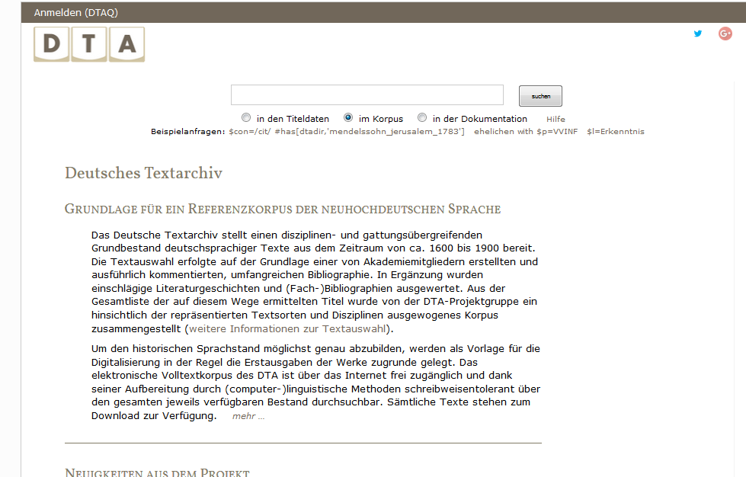
German text archive
available via https://deutschestextarchiv.de/ OR https://dwds.de OR https://kaskade.dwds.de/dstar/

Slide 33
German Text Archive
www.deutschestextarchiv.de
→ basic search functions, good for simple searches that require lots of context and perhaps even faksimiles of the original print; data for download
www.dwds.de
→ advanced search functions, best choice for most corpus queries; useful export functions
https://kaskade.dwds.de/dstar/
→ expert search functions, less limited than the dwds.de search interface; less ideal export functions; very good for advanced count operations

Slide 34
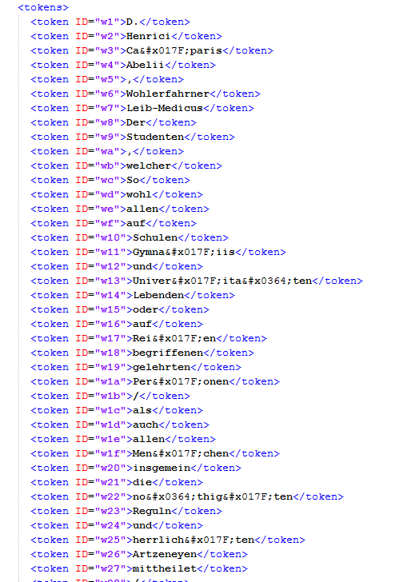
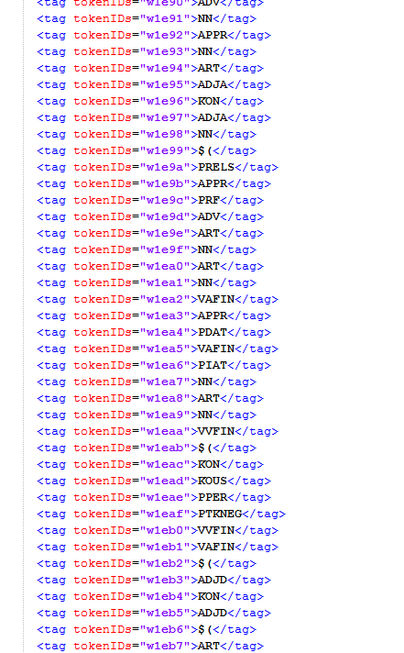
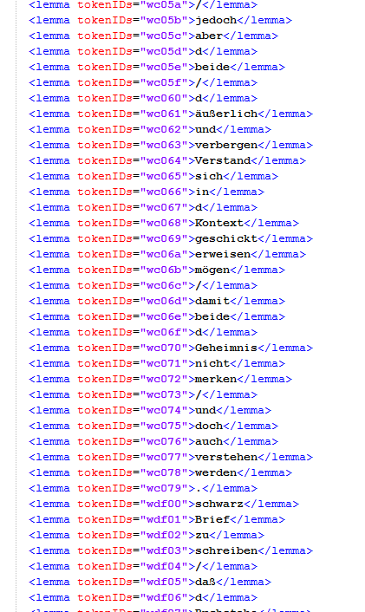
German Text Archive
DTA is tagged and lemmatized

Slide 35
German Text Archive
Search Syntax: DDC; see https://www.dwds.de/d/korpussuche (German) or https://www.cudmuncher.de/~moocow/software/ddc/querydoc.html (English)

Slide 36
German Text Archive / DWDS
annotati0n layers:
$w words/tokens (in DTA: Latin-1 text)
$l Lemma
$p part of speech
additionally in DTA:
$u original text in DTA
$v normalized word form
Notes:
CAB = Cascading Analysis Broker – Wortformnormalisierungs- und Lemmatisierungs-Tool des DTA

Slide 37
Examples
How can we search for...
the exact word form König 'king' (i.e. not Könige, Königs ...)
The lemma laufen 'go,run'
the plural forms Wagen vs. Wägen 'cars/waggons'
the construction ADJ werden 'become ADJ' (e.g. verrückt werden 'go crazy')
The sequence weil + personal pronoun + verb (e.g. weil ich sag das halt so)
Apostrophe with genitives of words ending in -s, e.g. des Korpus'
Infinitives without zu and zu infinitives
Frequency of ward vs. wurde across centuries
Notes:
Lösungen: 1. @König, 2. $l=laufen, 3. "/^W(a|ä)gen$/ with $p=NN" – Pluralformen von "Wagen" müssen manuell gesucht werden, weil Numerus nicht getaggt; 4. "$p=/ADJ./ #0 $l=werden" || "$l=werden #0 $p=/ADJ./" oder höherer Abstand für Ergebnisse mit Material zwischen ADJ und werden; 5. "$l=weil #0 $p=PPER #0 $p=/V.*/" 6. "/.*\'.*/", 7. /.*e(r|l)?n$/ with $p=/VV.*/ - r|l ist für tänzeln, jammern; 8. @ward || @wurde #less_by_date[1700,1799]......

Slide 38
Dstar

Slide 39
D* (Dstar)
https://kaskade.dwds.de/dstar/
alternative interface for the BBAW corpora
particularly suitable for frequency counts
documentation is a bit suboptimal

Slide 40
D* (Dstar)
Useful hints in this tutorial by Andreas Blombach http://sprachwissenschaft.fau.de/personen/daten/blombach/korpora.pdf
and in this blog post by Frank Wiegand: https://sprache.hypotheses.org/723

Slide 41
D* (Dstar)
Basic pattern for count queries:
COUNT ( insert normal DDC query here )
Example:
COUNT( $p = /NN/g ) #sep
(counts all common nouns)

Slide 42
D* (Dstar)
by-Operator: count by $l (Lemma), $p (POS) etc.
COUNT ( insert ddc query here )
Example:
COUNT( $p = /NN/g ) #BY($l) #sep
(counts all common nouns by lemma)

Slide 43
D* (Dstar)
Basic pattern for frequency counts:
COUNT ( insert normal ddc query here )
More complex example:
count( "$w=/[Jj]e/g $w=/.*er/g=1" && "$w=/desto/g $w=/.*er/g=2" )

Slide 44
The mother of all (German) corpora: DeReKo

Slide 45
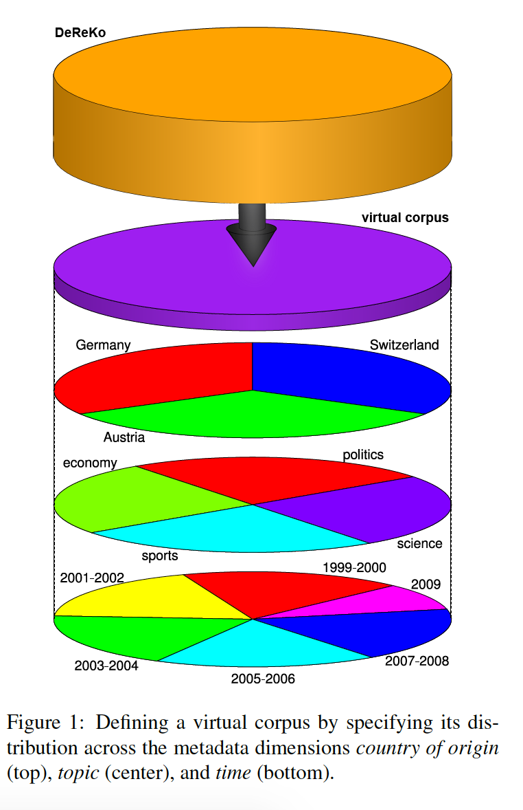
DeReKo
since 1964
biggest collection of corpora of present-day German
not a balanced corpus – instead, it is a collection of "archives" designed in such a way that one can create "virtual corpora" balanced for aspects relevant for the current research question
(from Kupietz et al. 2010)

Slide 46
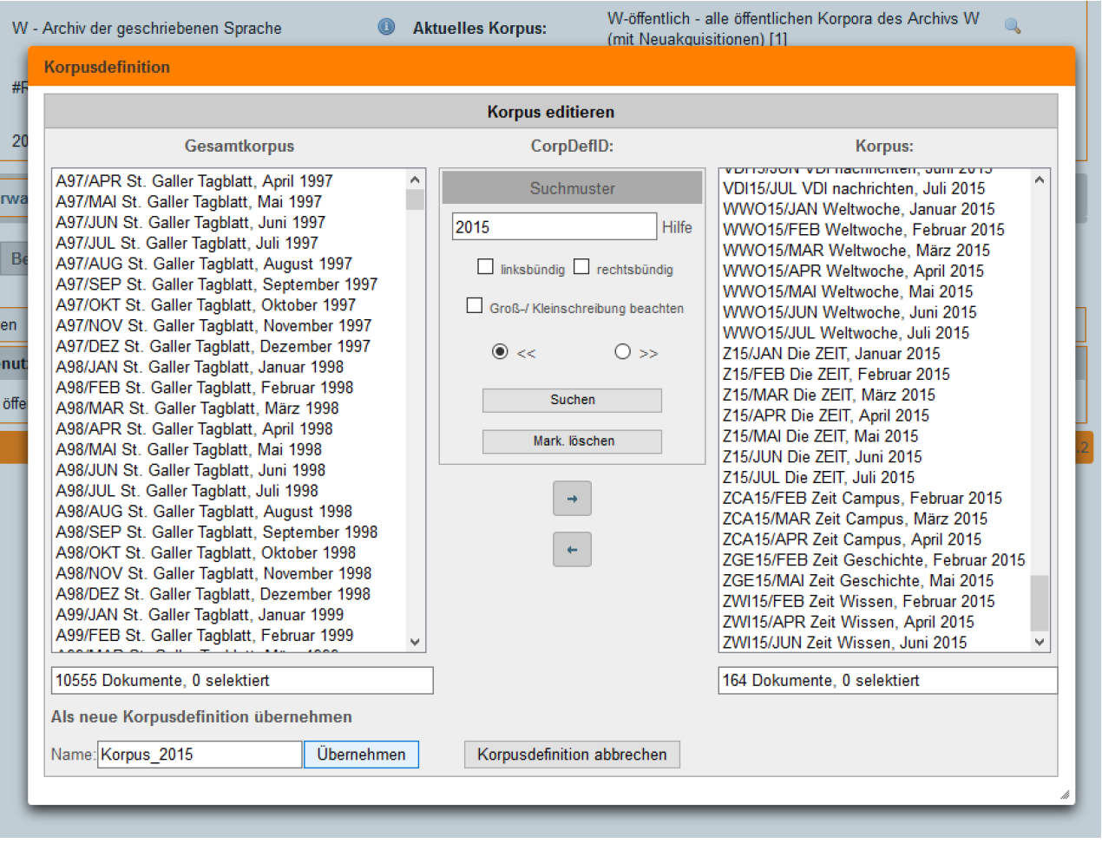
Create virtual corpora

Slide 47
The concept of DeReKo
DeReKo as "Urstichprobe" 'original sample' (Kupietz 2010)
i.e. no ready-to-use sample but a data pool from which the user can create a sample balanced for relevant criteria

Slide 48
Terminology
DeReKo uses the following terms:
Dokument 'document: contains at least one text (e.g. a novel) or multiple text (e.g. one month of newspaper articles from the St. Galler Tagblatt)
Korpus 'corpus': contains multiple documents, e.g. all documents of the St. Galler Tagblatt
Virtuelles Korpus 'virtual corpus': user-defined collection of multiple documents or corpora.
Archiv 'archive': uppermost level of DeReKo. E.g. "archive of written language" contains all corpora of written language in DeReKo (e.g. the St. Galler Tagblatt corpus).
Quelle: https://www.bubenhofer.com/korpuslinguistik/kurs/index.php?id=cosmas_www_erste.html
Notes:
Virtuelles Korpus: Dabei kann ein Dokument gleichzeitig in mehreren virtuellen Korpora enthalten sein (deshalb "virtuell"). Es gibt z.B. das virtuelle Korpus "public", das alle öffentlich verfügbaren Dokumente geschriebener Sprache enthält (darunter auch das Korpus des St. Galler Tagblatts. Der Clou hier ist, dass man selber virtuelle Korpora definieren kann. Wenn man sich z.B. für Schweizer Pressesprache interessiert, definiert man sich ein virtuelles Korpus, das alle verfügbaren Schweizer Zeitungen enthält.

Slide 49
DeReKo
accessible via COSMAS II interface
advantage: relatively flexible search options
disadvantage: limited export options (max. 10,000 hits)

Slide 50
Regular expressions in COSMAS
Wildcards (Source: http://www.ids-mannheim.de/cosmas2//win-app/hilfe/suchanfrage/eingabe-grafisch/syntax/WORT.html)
* 0, 1, 2, … characters.
+ 0 or 1 character
? 1 character
The placeholders can be used multiple times within one word form.
They can be placed anywhere within a word form.
When using * at least two characters have to be speficfied.
Wildcard function can be escaped with \
Notes:
Die regulären Ausdrücke sind anders als sonst – man beachte v.a. das + und das ?: das ? funktioniert hier wie der . anderswo, das + wie .? - statt .* kann man hier aber das Fragezeichen mit * kombinieren.
Für KWIC: Lookahead assertion (?<=^..... )

Slide 51
Annotation of COSMAS
Largest archive W not pos-tagged
However, there is a subcorpus with tagged texts:
Tagged-C, Tagged-C2 (from 2010): tagged with Connexor
Tagged-T, Tagged-T2 (from 2010): tagged with TreeTagger
The tagged archives still have > 1 billion tokens.

Slide 52
Example
How can we find
wegen + NP
weil + personal pronoun + Verb (weil ich sag das halt so)
Frequency of ward vs. wurde in historical texts
Usage variants of the verb kommunizieren

